Slide 1
Ranger 3.0 Troubleshooter
Master List for Issues
Note:
Run the slide and click on buttons, videos or hyperlinks as necessary.
In Case of incorrect selection, rerun the slide or go to previous

Slide 2
Ranger 3.0 Troubleshooter
Total no. of error covered in TT : 5
Select Box for Listed Issues
S No. | Module | Error Details | Click on Link | Remarks
1 | Camera | Top/Bottom DM not found
2 | Power | Bot not power up
3 | WMD | Wheel motor driver issue
4 | ODS | ODS disconnection
5 | Hard Emergency | Emergency applied automatically
6 | LMD | Lift motor & driver related issue
Click
Click
Click
Click
Click
Click

Slide 3
Ranger 3.0 Troubleshooter
Camera Related Errors
Available Version
Ver 1.0

Slide 4
Ranger 3.0 Troubleshooter
Camera Related Related Error
Ver.1.0
Start
Note:
Run the slide and click on buttons, videos or hyperlinks as necessary. DO NOT USE ARROW KEYS
In case of incorrect selection, rerun the slide or go to previous slide
FlowChart Reference

Slide 5
Ranger 3.0 Troubleshooter
S N | Error Flag | Bit Name | Error Description | Reference Link for Resolution | Remarks
1. | (0,0,0,64,0,0,0,0) | camera_error | Camera disconnection error or CAM freeze issue
2. | 0,0,0,64,0,0,0,131 | ERR_CAMERA_DISCONNECT_TOP | Top Camera Disconnection
3. | (0,0,0,0,32,0,0,0) | invalid_dx_dy_theta | Outliers
4. | {0,0,0,0,0,0,2,0} and {0,0,0,0,0,0,4,1} | Possible slip observed | DM not found
5. | {0,0,0,0,0,0,2,31} | Butler drifting by high current | Manual Intervention is done for Bottom DM not found and retrace success
6. | NA | NA | Camera calibration Fail
Click
Click
Click
Click
Click
Click

Slide 6
Ranger 3.0 Troubleshooter
Camera Related Error
Available Version
Ver 1.0

Slide 7
Ranger 3.0 Troubleshooter
Camera Related Error (DM not found Error)
Ver.1.0
Start
Note:
Run the slide and click on buttons, videos or hyperlinks as necessary. DO NOT USE ARROW KEYS
In case of incorrect selection, rerun the slide or go to previous slide
FlowChart Reference

Slide 8
Ranger 3.0 Troubleshooter
Error Description:
Follow this page if following is happened in BoT
Ranger is not able to decode Either Top or Bottom barcode .
Ranger is showing DM not found error in logs while operation.
Next

Slide 9
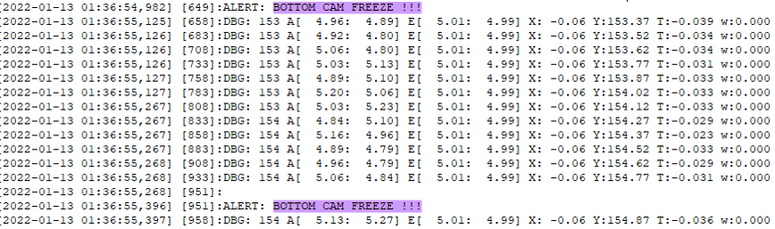
Ranger GTP 3.0 Troubleshooter
Check the Camera Freeze or camera disconnection related error in navigation logs as mentioned in support link document.
SN | Support Links
1 | Procedure to Check Nav Log
Did we receive the Camera Freeze issue in nav log?
YES
NO
Back
Next

Slide 10
Procedure for Checking Nav Log
Purpose of Document : Explain the step by step Procedure for Checking Nav Log at customer site.
SN | Version | Prepared / Revised | Checked / Approved |  | Ref Details
1 | 1.0 | Rishabh | Monti | Sankalp

Slide 11
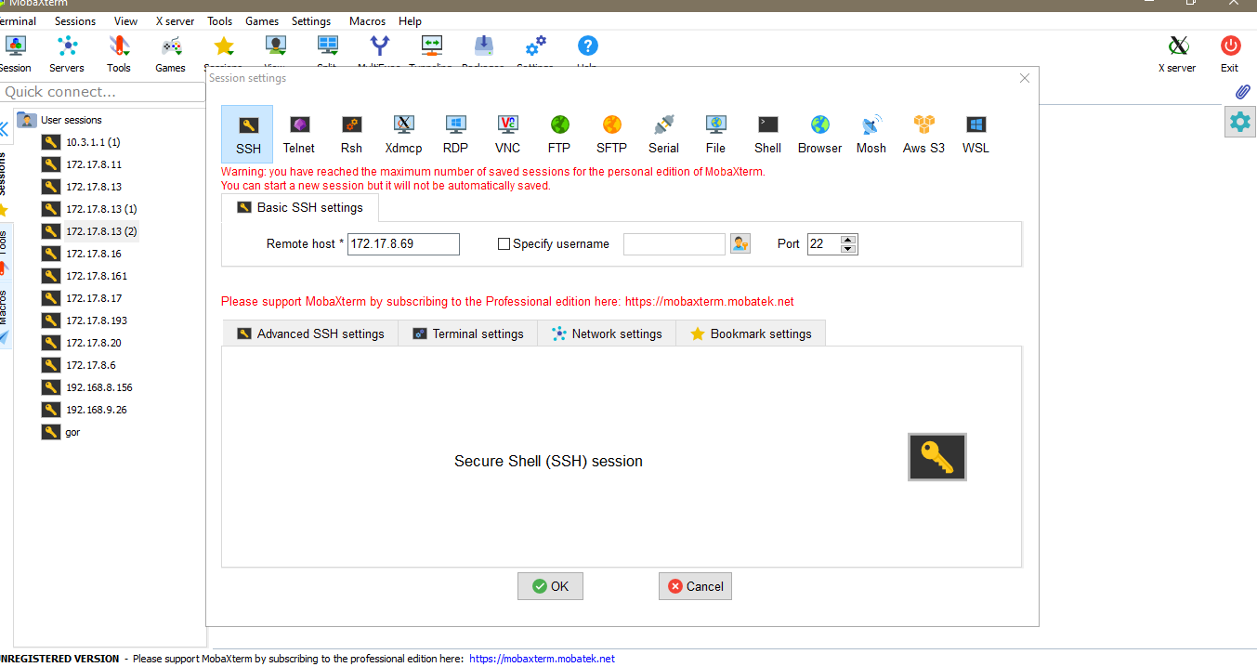
Procedure for Checking Nav Log
Step-1 Turn ON the bot and login in the butler via Mobaxterm or kitty.
1
2
3

Slide 12
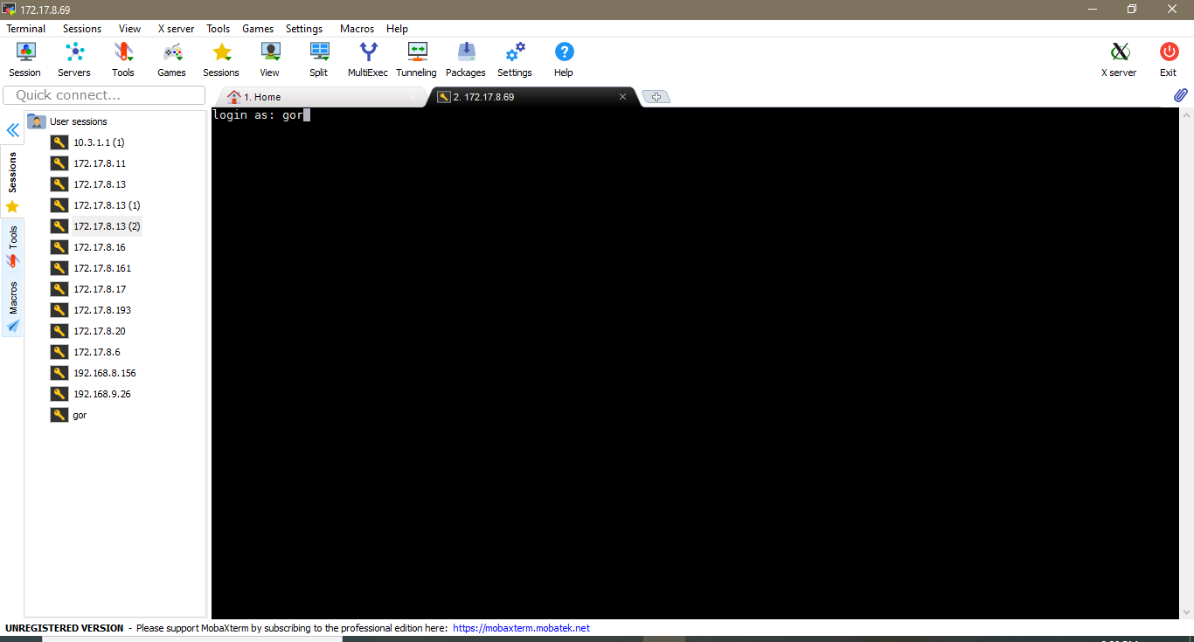
Procedure for Checking Nav Log
Step-2 After that type “gor” and than click on Enter button.
Step-3 Now enter the password – “apj0702”

Slide 13
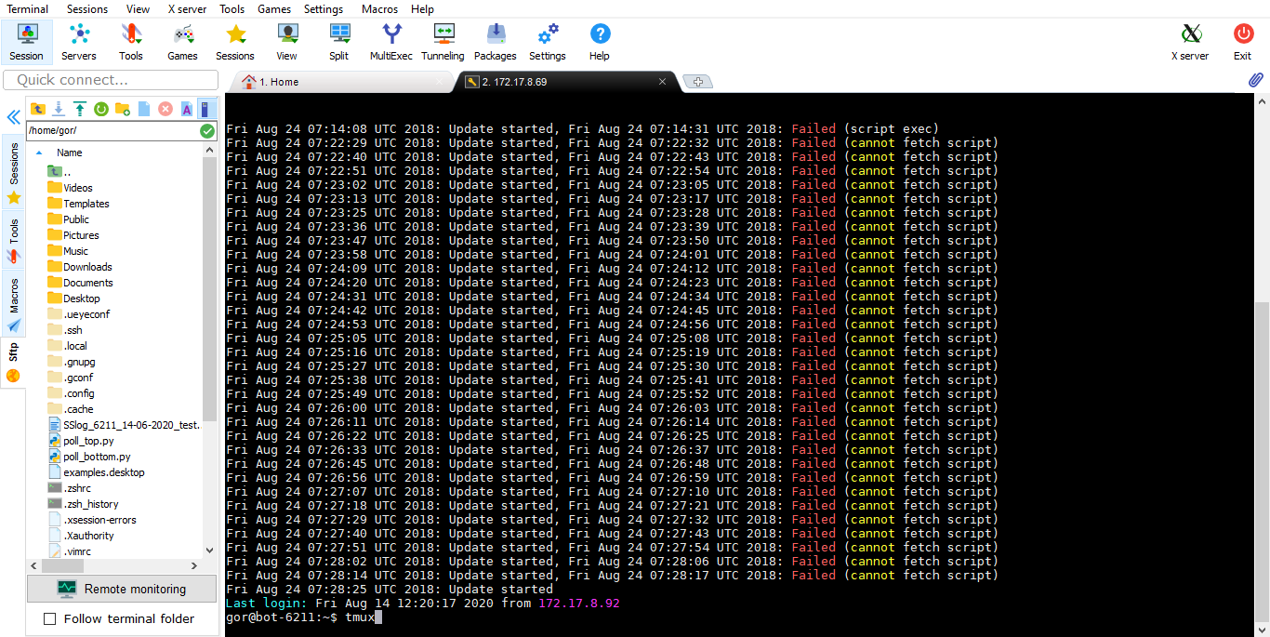
Procedure for Checking Nav Log
Step-4 After that type “tmux” for clear the screen and than click on “Enter” key.

Slide 14
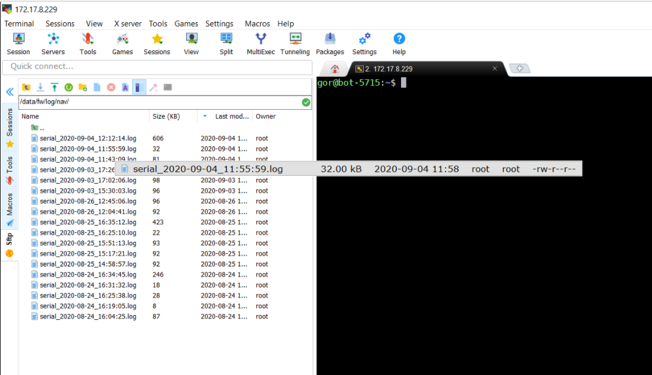
Procedure for Checking Nav Log
Step-5 Now enter command ‘/data/fw/log/nav’ in Mobaxterm window and press enter tab. Here we should find out the error time when error is occurred. After that download the log. For example, in below screen shot, we can see the log
time is 11:55 am to 11:58am. Now Download the desired logs.

Slide 15
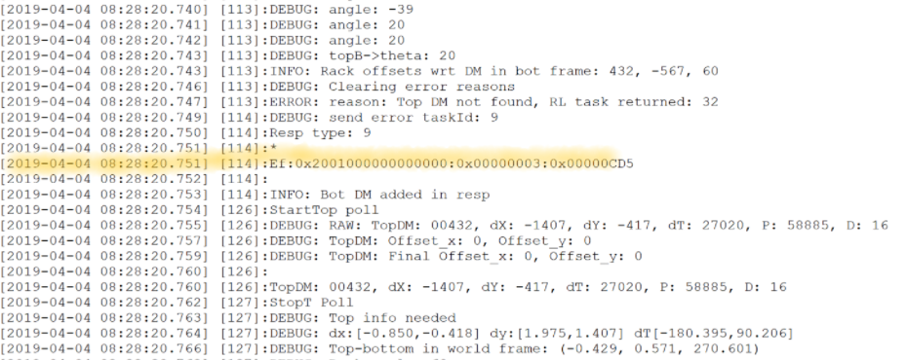
Procedure for Checking Nav Log
Step-6 Now a window will open which is shown in below figure. Here we can check the DM not found error.

Slide 16
END
Return back to error slide for further troubleshooting

Slide 17
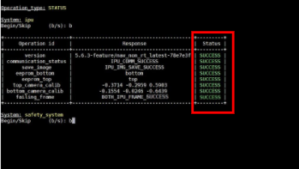
Ranger 3.0 Troubleshooter
Perform IPU diagnostic as mentioned in support link document .
SN | Support Links
1 | Procedure To Perform IPU Diagnostic
Did diagnostic test Pass?
YES
NO
Back
Next

Slide 18
Ninja Diagnostic Process
SN | Version | Date | Prepared / Revised | Checked / Approved | Ref Details
1 | V 1.0 | 19/8/2021 | Asheesh.y | Anand.c

Slide 19

Ninja Diagnostic Process
Purpose of Document : Explain the step by step Procedure for Diagnostic in Ninja Bots at GFC-1 and customer site.
STATUS:
Read and understand the procedure carefully.
EQUIPMENT REQUIRED:
Windows Laptop
MobaXtrum
Activity Name | No. of Required operator | Time Taken
Ninja Diagnostic Process | 01 | 10 min

Slide 20
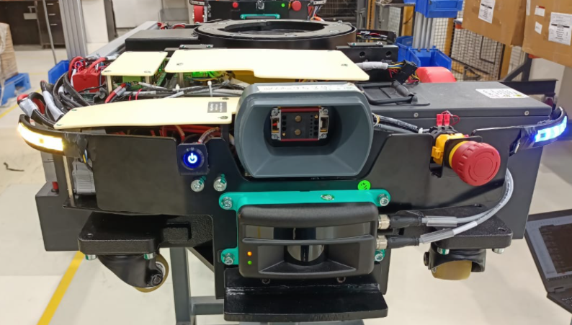
Ninja Diagnostic Process
Steps to be followed:
Turn ON the Bot.
Press The Push Button.

Slide 21
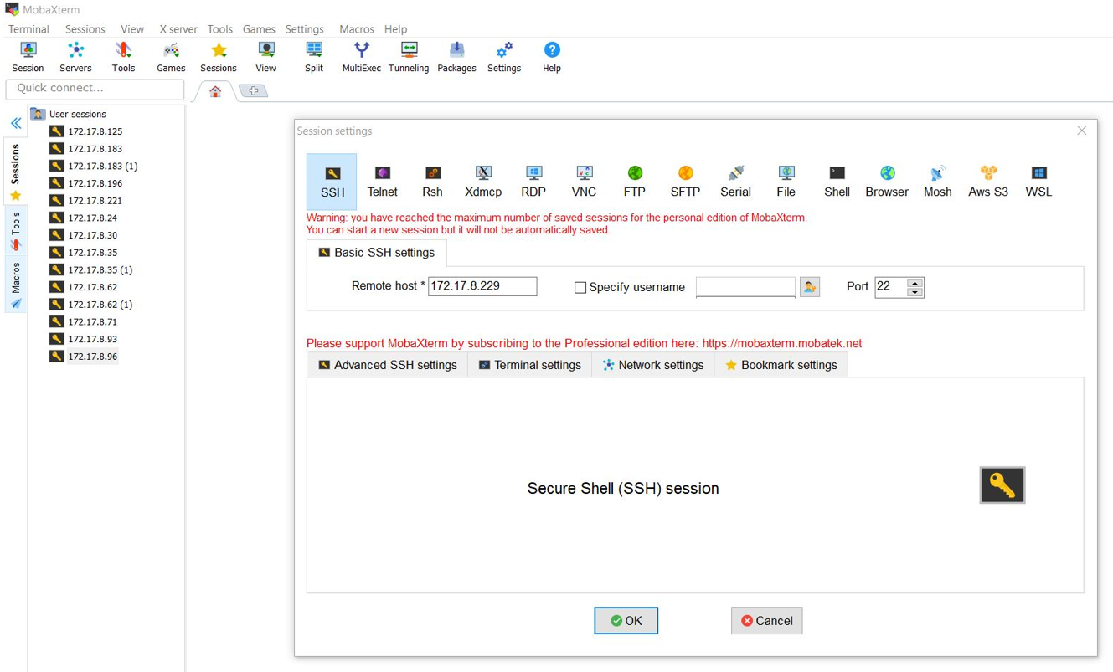
Ninja Diagnostic Process
Now open the MobaXturm go to the Session and then go to SSH & enter the IP and click on OK button.
1
2
3
4

Slide 22
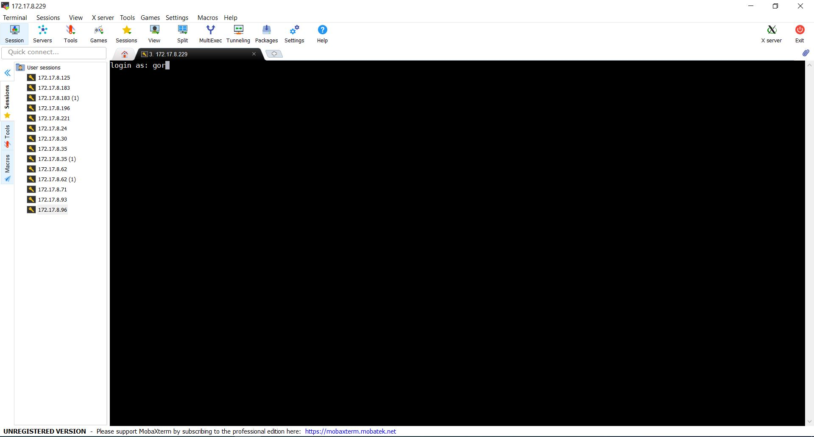
Ninja Diagnostic Process
Now it will ask for login as just type gor & press enter key. After that type Password apj0702 and press the enter kay.

Slide 23
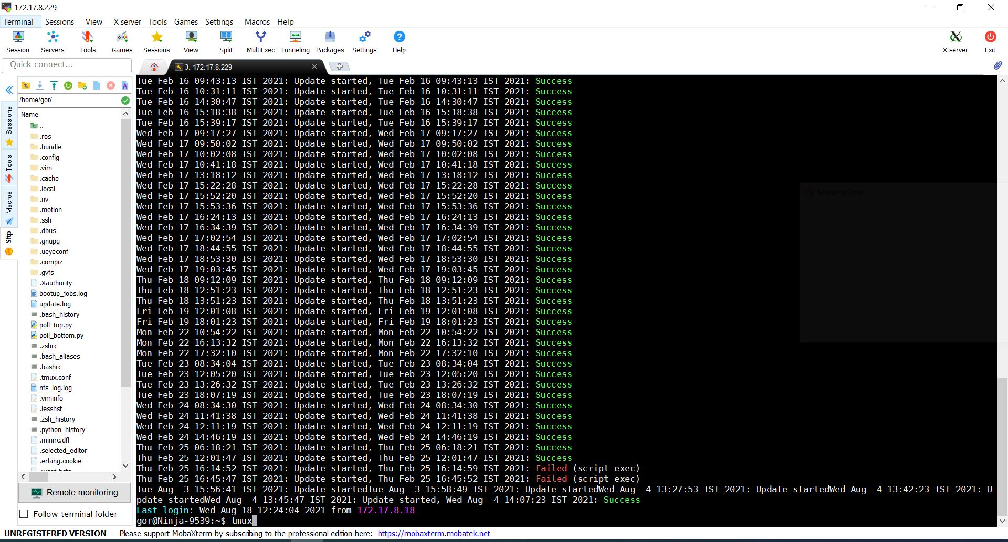
Ninja Diagnostic Process
Now type the tmux and press enter key.

Slide 24
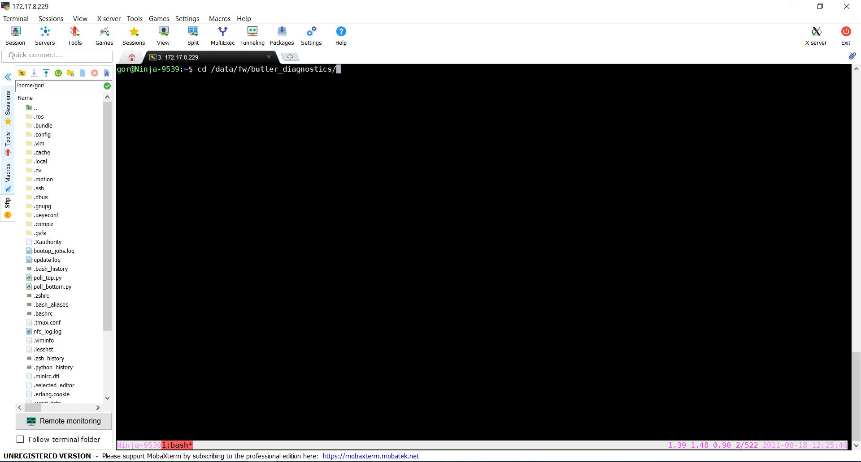
Ninja Diagnostic Process
Now type cd /data/fw/butler_diagnostics/ and press enter key.

Slide 25
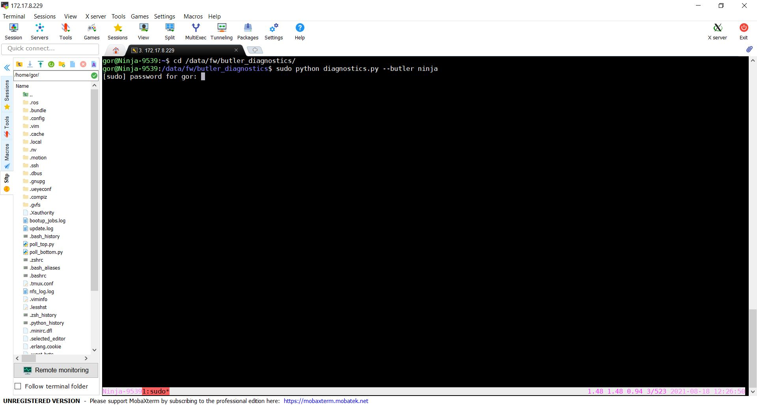
Ninja Diagnostic Process
After that type sudo python diagnostics.py --butler ninja & press enter kay and then type the password apj0702.

Slide 26
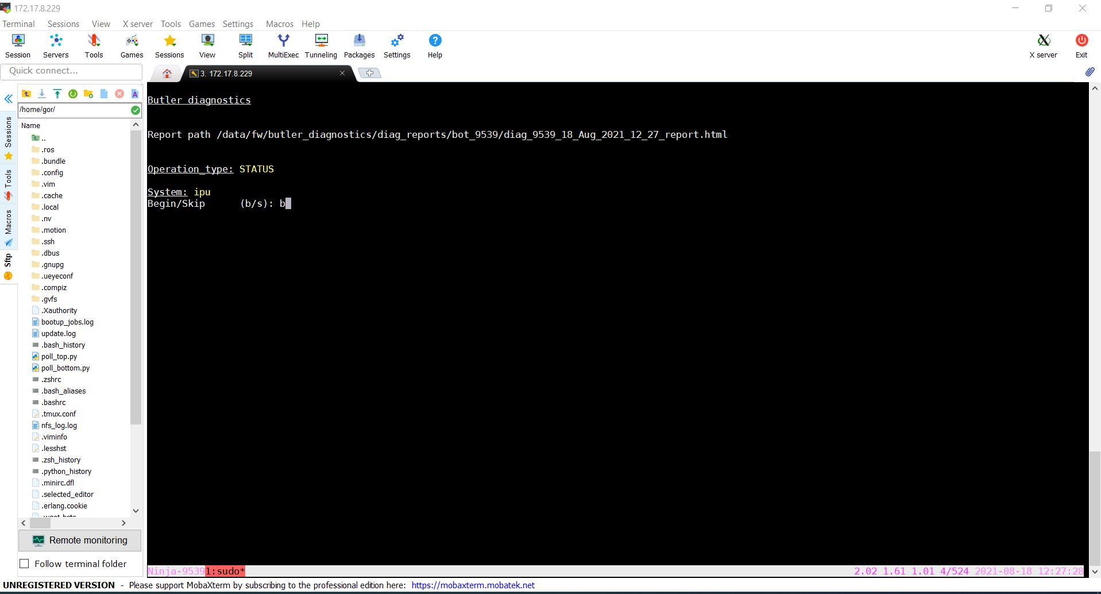
Ninja Diagnostic Process
First it will check the IPU status as shown in the below image.
Just type b and press the enter key.

Slide 27
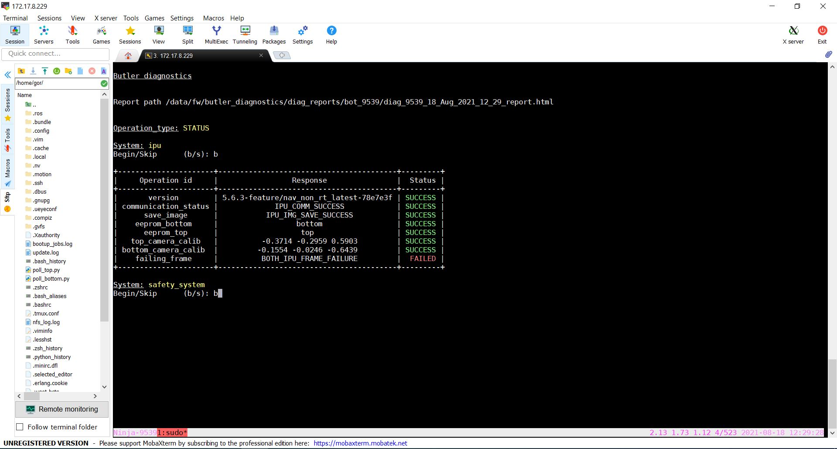


Ninja Diagnostic Process
After that it will check the health of IPU and print the status as shown in the below image.
Note :- All status should be SUCCESS.

Slide 29
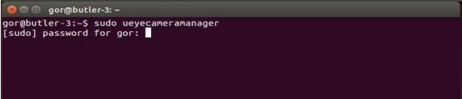
Ranger 3.0 Troubleshooter
Check camera focusing as mentioned in support link document.
Perform IPU diagnostics and check if the issue is resolved.
SN | Support Links
1 | Procedure To Camera Focusing
Is your error fixed?
YES
NO
Back
Next

Slide 30
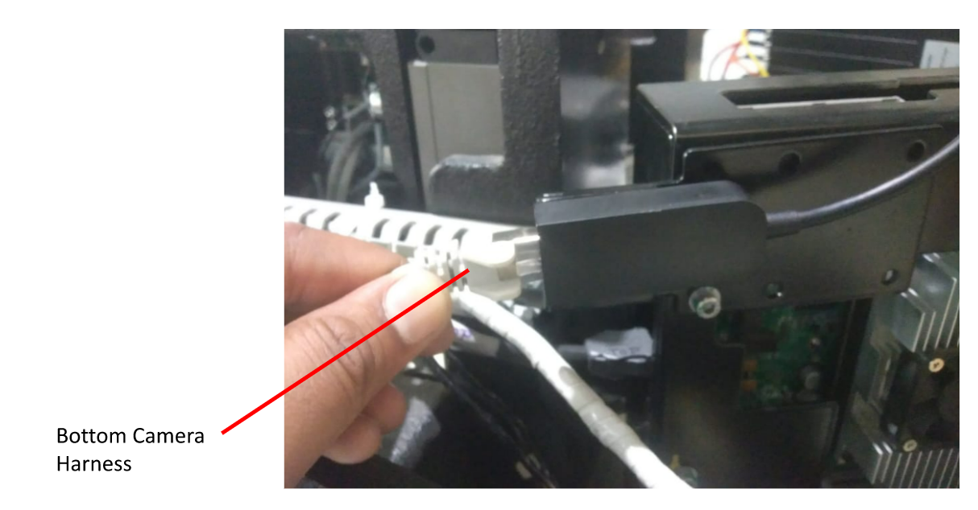
Ranger 3.0 Troubleshooter
Replace the Dongle as mentioned in support link document.
Again restart the Ranger and check if the issue is resolved.
SN | Support Links
1 | Procedure To Dongle Replacement
Is your error fixed?
YES
NO
Back
Next

Slide 31
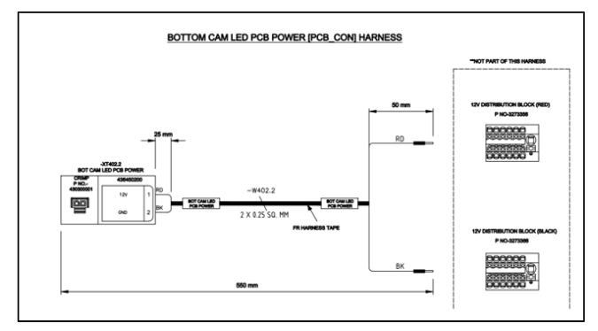
Ranger 3.0 Troubleshooter
Check camera power harness to camera led PCB as mentioned in support link document .
Again restart the Ranger and check if the issue is resolved.
SN | Support Links
1 | Procedure To Check Camera Power Harness to CAM Led PCBA
Is your error fixed?
YES
NO
Back
Next

Slide 32
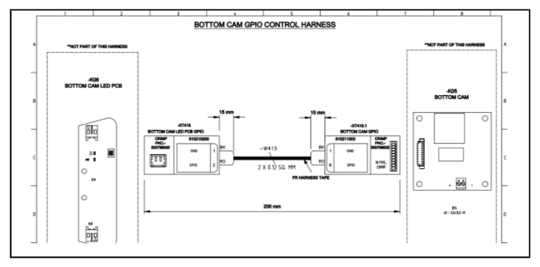
Ranger 3.0 Troubleshooter
Check camera related harness as mentioned in support link document.
Restart the bot and again check if the issue is resolved.
SN | Support Links
1 | Procedure To Check Camera Related Harness
Is your error fixed?
YES
NO
Back
Next

Slide 33
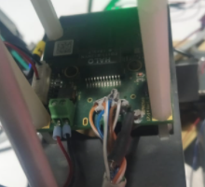
Ranger 3.0 Troubleshooter
Check for Ethernet wire soldering on camera PCB as mentioned in support link document.
If ethernet wire is not proper soldering, solder it again.
Restart the Ranger and check if the issue is resolved.
SN | Support Links
1 | Procedure To Check Ethernet Wire Soldering
Is your error fixed?
YES
NO
Back
Next

Slide 34
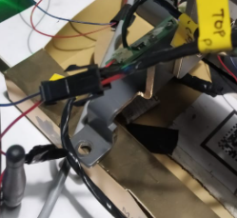
Ranger 3.0 Troubleshooter
Check if 12V supply harness of Camera is loose as mentioned in support link document.
Restart the Ranger and check if the issue is resolved.
SN | Support Links
1 | Procedure To Check 12V Supply Harness of Camera
Is your error fixed?
YES
NO
Back
Next

Slide 35
Ranger 3.0 Troubleshooter
Replace camera unit if CAM_FREEZE issue persist as mentioned in support link document.
Restart the Ranger and check if the issue is resolved.
SN | Support Links
1 | Procedure To Replace Camera Assembly
Is your error fixed?
YES
NO
Back
Next

Slide 36
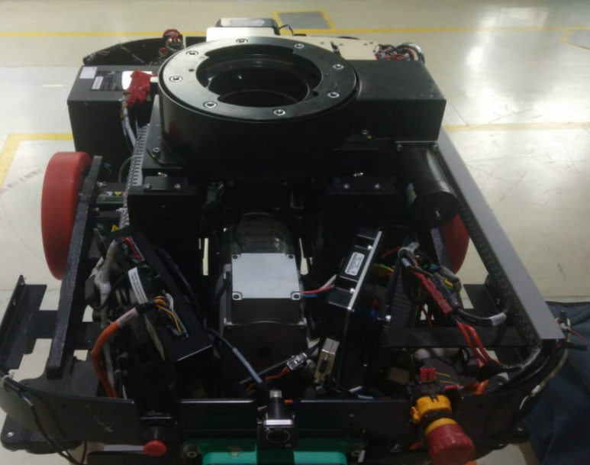
Ranger 3.0 Troubleshooter
Replace IMB assembly as mentioned in support link document.
Restart the Ranger and check if the issue is resolved.
SN | Support Links
1 | Procedure To Replace IMB Assembly
Is your error fixed?
YES
NO
Back
Next

Slide 37
Ranger 3.0 Troubleshooter
If we do not get any camera freeze related issue in nav log, it means this is not camera related issue.
Done
Back
Next

Slide 38
Ranger 3.0 Troubleshooter
If previous steps could not resolve the issue, create a site support ticket for resolution of error.
Done
Back
Next

Slide 39
Ranger 3.0 Troubleshooter
END OF TROUBLESHOOT
Begin Again

